Slide 1
Cryptography Lab EXP - 8

Slide 2
What is SSL/TLS?
SSL(Secure Socket Layer) is a protocol that encrypts data transmitted between computers and provides secure communication over a computer network.
The SSL Layer works between Application and Transport layer.
TLS(Transport Layer Security) is a newer version of SSL with better security and higher flexibility due to enhanced algorithms such as AES and SHA and stronger key exchange mechanism.
‘HTTPS’ indicates that the website is using some protocol for enhanced security.

Slide 3
Importance of SSL/TLS
SSL/TLS encrypts the data being transmitted between the client and the server, making it unreadable to anyone who might intercept it. This prevents unauthorized access and ensures security and data integrity.
SSL/TLS provides authentication mechanisms that verify the identity of the server to the client, thereby providing security against attacks such as phishing and man-in-the-middle attack.

Slide 4
Handshake Process
The SSL/TLS handshake is the initial communication between the client and server to establish a secure connection. During this process, the client and server agree on encryption parameters, including the encryption algorithms and cryptographic keys to be used for the session.
Data Integrity and Authentication: SSL/TLS also provides mechanisms for ensuring the integrity and authenticity of data. This is typically achieved using cryptographic hash functions and digital signatures. Hash functions generate a unique "digest" of the data, which is then signed by one party and verified by the other to ensure that the data has not been tampered with.
Session Termination: Once the communication is complete, the SSL/TLS session is terminated. Depending on the configuration, the session keys may be discarded to ensure forward secrecy, meaning that even if an attacker were to obtain the server's private key in the future, past communications would still be secure.

Slide 5
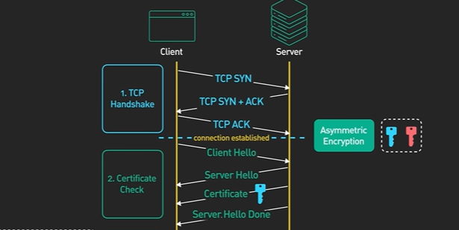
Handshake Process

Slide 6
Encryption & Decryption using SSL/TLS
Key Exchange:
One of the key aspects of the handshake is the exchange of cryptographic keys. This is typically done using asymmetric encryption, where the client and server each have a public-private key pair. The client sends its public key to the server, and the server sends its public key to the client. This allows both parties to securely exchange a shared secret key without exposing it to potential eavesdroppers.
Symmetric Encryption:
Once the shared secret key is established, symmetric encryption is used to encrypt the actual data being transmitted. Symmetric encryption is much faster than asymmetric encryption and is typically used for bulk data encryption. Common symmetric encryption algorithms include AES (Advanced Encryption Standard).
Data Transmission:
With the shared secret key in place, the client and server can securely encrypt and decrypt data exchanged during the session. This ensures that even if the data is intercepted by an attacker, it cannot be understood without the proper decryption key.

Slide 7
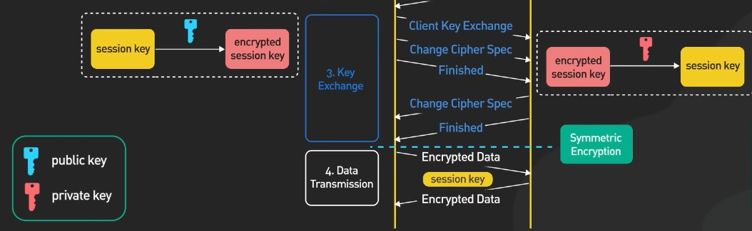
Encryption & Decryption using SSL/TLS

Slide 8
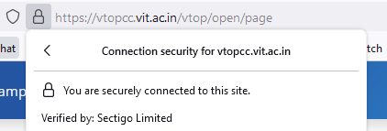
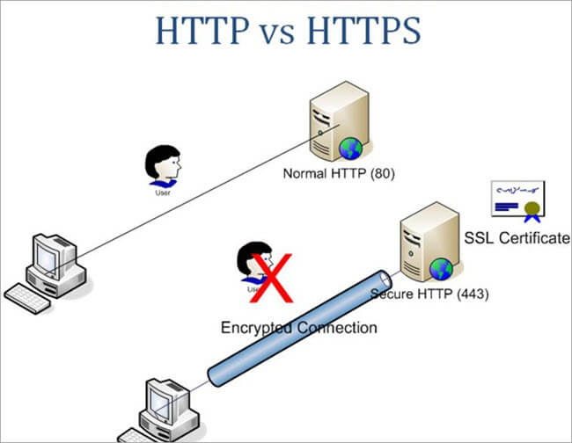
What are SSL/TLS certificates?
SSL/TLS certificates are digital documents that authenticate the identity of a website or server and enable secure communication over the internet. It is a data file issued by the authorized Certificate Authority (CA).

Slide 9

Who are the Certificate Authorities?
Certificate Authorities (CAs) are trusted entities that issue digital certificates to secure communications over the internet. These organizations are responsible for validating the identities of entities requesting certificates and issuing them a certificate that browsers and other clients can use to verify those identities.

Slide 10
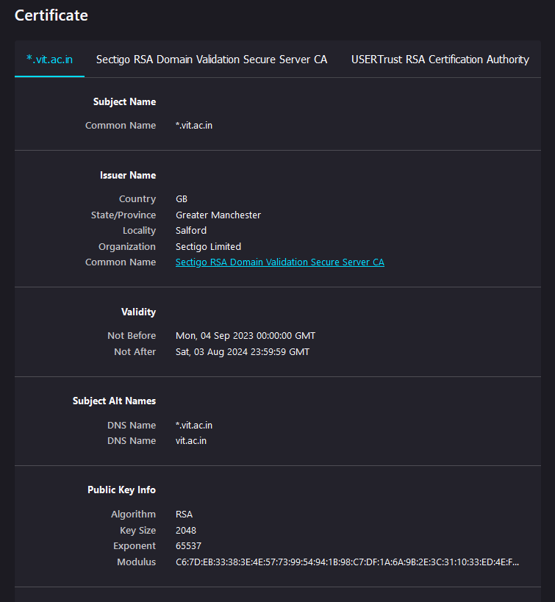
SSL uses the X.509 format, and it includes the following information:
Version: The version number of the certificate data format as per X.509.
Serial number: Unique identifier of the certificate assigned by CA
Public Key: The owner's public key
Subject: Owner's name, address, country, and domain name
Issuer: Name of the CA who issued the certificate
Valid-From: The date the certificate is valid from
Valid-To: The expiration date
Signature Algorithm: The algorithm used to create the signature
Thumbprint: The hash of the certificate
Thumbprint Algorithm: The algorithm used to create a hash of the certificate

Slide 11
Types of SSL/TLS Certificates
There are three recognized types of SSL certificates, based on their validation level:
Domain Validation (DV): Blogs, Personal Websites
Organization Validation (OV): Commercial Websites
Extended Validation (EV): Ecommerce, Financial, Legal Websites
Within these authentication types, there are different variations available:
Single Domain: Useful for small businesses that need to secure only a single domain.
Multi-Domain: Useful for organizations managing multiple domains or subdomains
Wildcard: Ideal for businesses with large websites having large no. of subdomains

Slide 12
Steps in Certificate Validation:
I:Client Hello: Client initiates handshake.
II:Server Hello: Server responds and selects parameters.
III:Certificate: Server sends SSL/TLS certificate.

Slide 13
Certificate Validation Process:
Certificate Chain: Verify issued by trusted CA.
Certificate Revocation: Check for revocation.
Hostname Verification: Ensure domain name matches.

Slide 14
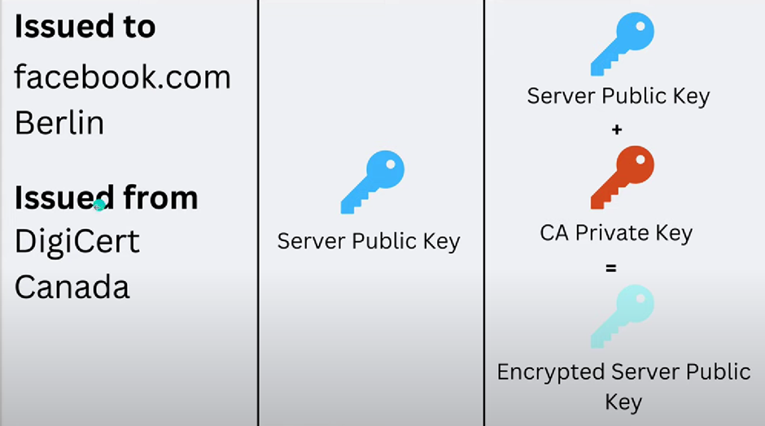

Slide 15
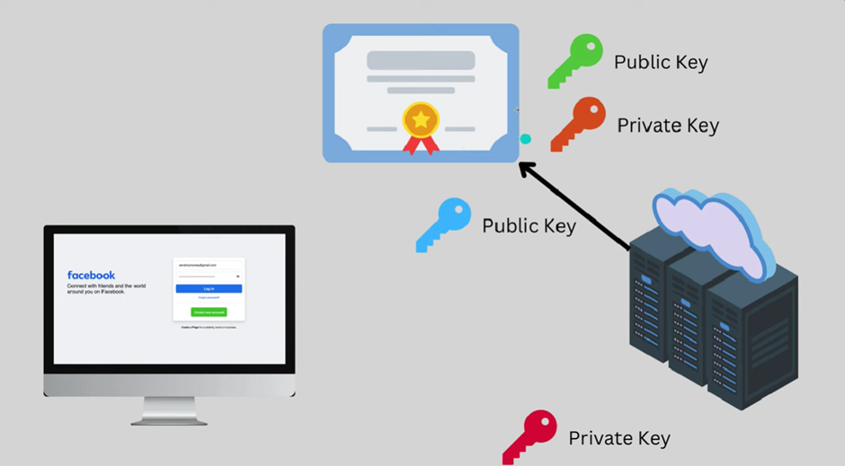

Slide 16
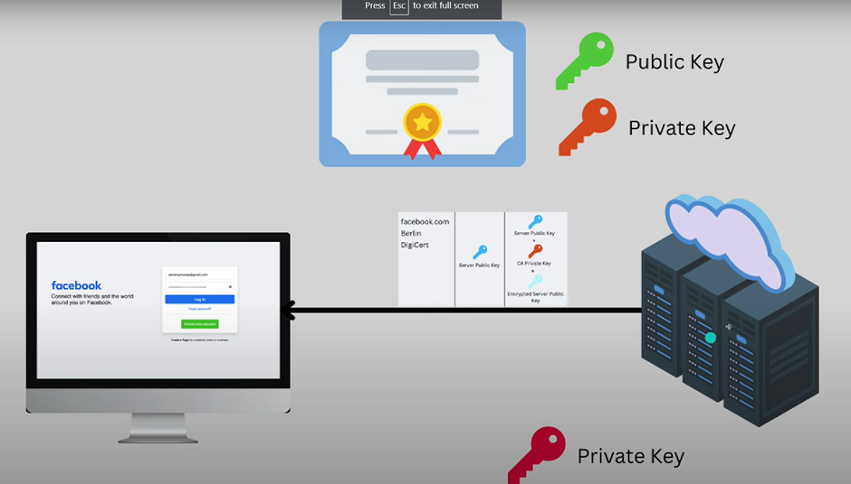

Slide 17
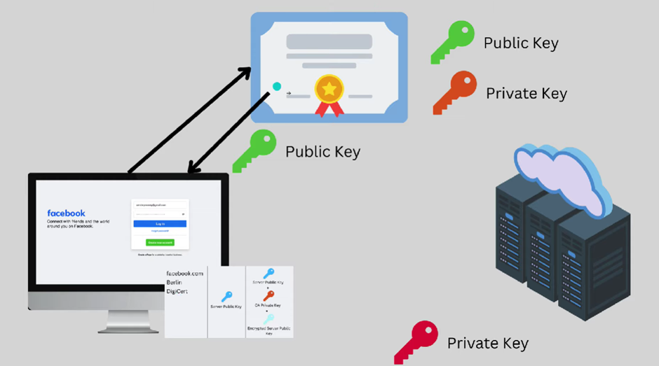

Slide 18
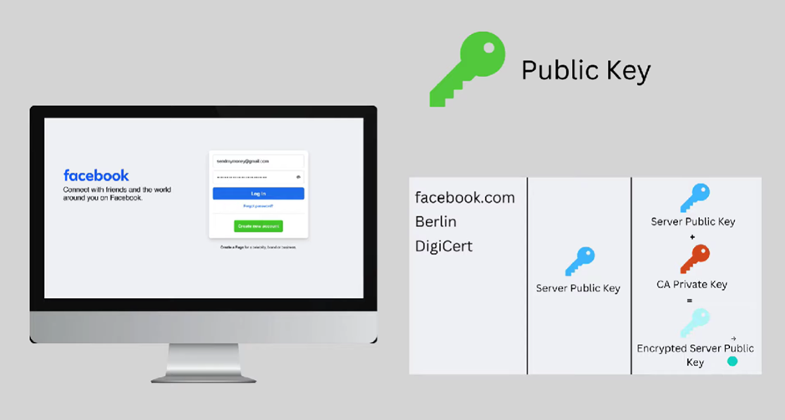

Slide 19
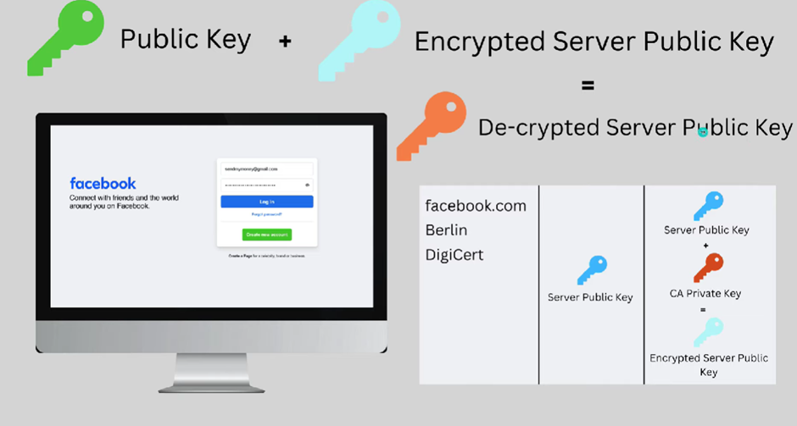

Slide 20
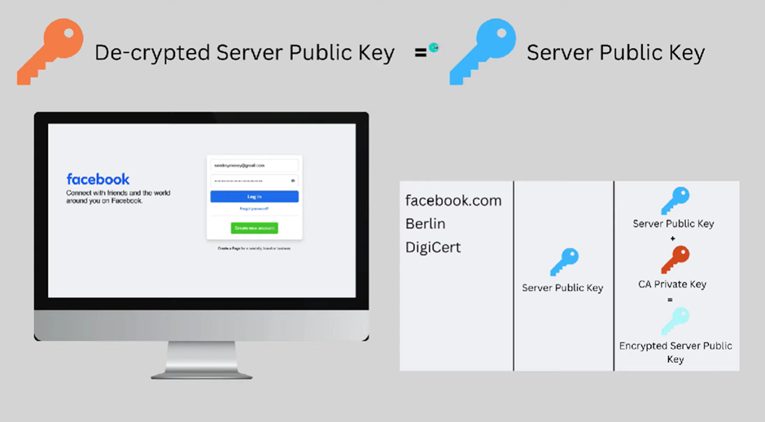

Slide 21
Real-world Applications and Use Cases:
Web Servers (HTTPS):
-SSL/TLS is extensively used to secure communication between web browsers and servers via HTTPS (HTTP over SSL/TLS).
-Enhances security by encrypting data exchanged between users and websites, protecting sensitive information such as login credentials, financial transactions, and personal data from eavesdropping and tampering.
-Provides authentication, ensuring users are connecting to legitimate websites and not imposters.

Slide 22
Email Servers (SMTPS, POP3S, IMAPS):
-SSL/TLS can secure email communication between clients (such as email programs) and servers.
-Encrypts email contents and login credentials, preventing interception and unauthorized access to email accounts.
-Verifies the identity of email servers, reducing the risk of phishing attacks.

Slide 23
Virtual Private Networks (VPN):
-SSL/TLS is used to establish secure VPN connections between clients and servers.
-Encrypts all data traffic passing through the VPN tunnel, ensuring confidentiality and privacy, especially when accessing sensitive corporate networks or public Wi-Fi hotspots.
-Authenticates VPN servers, preventing man-in-the-middle attacks.

Slide 24
Instant Messaging and Voice/Video Calls:
-SSL/TLS can secure communication in instant messaging platforms, VoIP (Voice over Internet Protocol), and video conferencing applications.
-Encrypts messages, voice, and video data exchanged between users, safeguarding privacy and confidentiality.
-Authenticates servers, reducing the risk of man-in-the-middle attacks.

Slide 25
File Transfer Protocols (FTPS, SFTP):
-SSL/TLS secures file transfers over FTPS (FTP over SSL/TLS) and SFTP (SSH File Transfer Protocol).
-Encrypts file contents and authentication credentials during transmission, protecting sensitive data from interception and unauthorized access.
-Authenticates file servers, ensuring clients connect to trusted servers.

Slide 26
What is OpenSSL?
OpenSSL is a
Opensource toolkit for SSL/TLS
Has command line tools for generating keys, certificates.
Also to perform cryptographic actions.

Slide 27
Why OpenSSL?
OpenSSL is widely used for:
Creating SSL/TLS certificates for securing websites and applications.
Generating cryptographic keys and managing certificates.
Testing and debugging SSL/TLS configurations.

Slide 28
Installing OpenSSL
Search for OpenSSL Windows in Google
Click this link https://wiki.openssl.org/index.php/Binaries
Click OpenSSL for Windows https://slproweb.com/products/Win32OpenSSL.html
Choose Windows Architecture whether 64bit or 32 bit.
Install it and add to environmental paths.

Slide 29
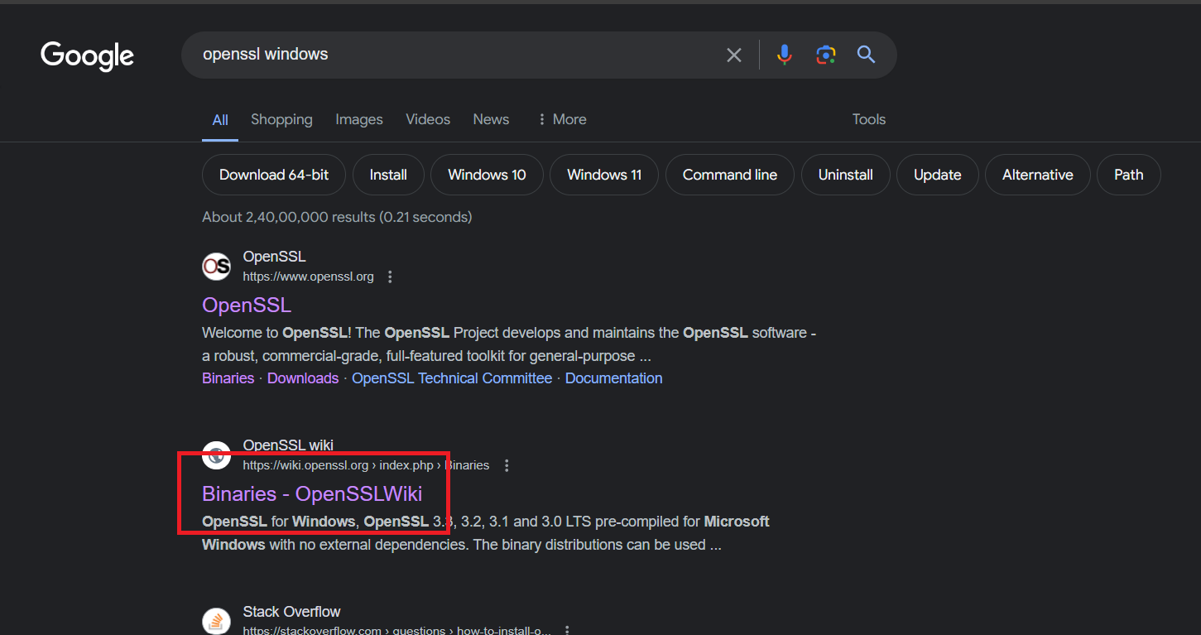
Website

Slide 30
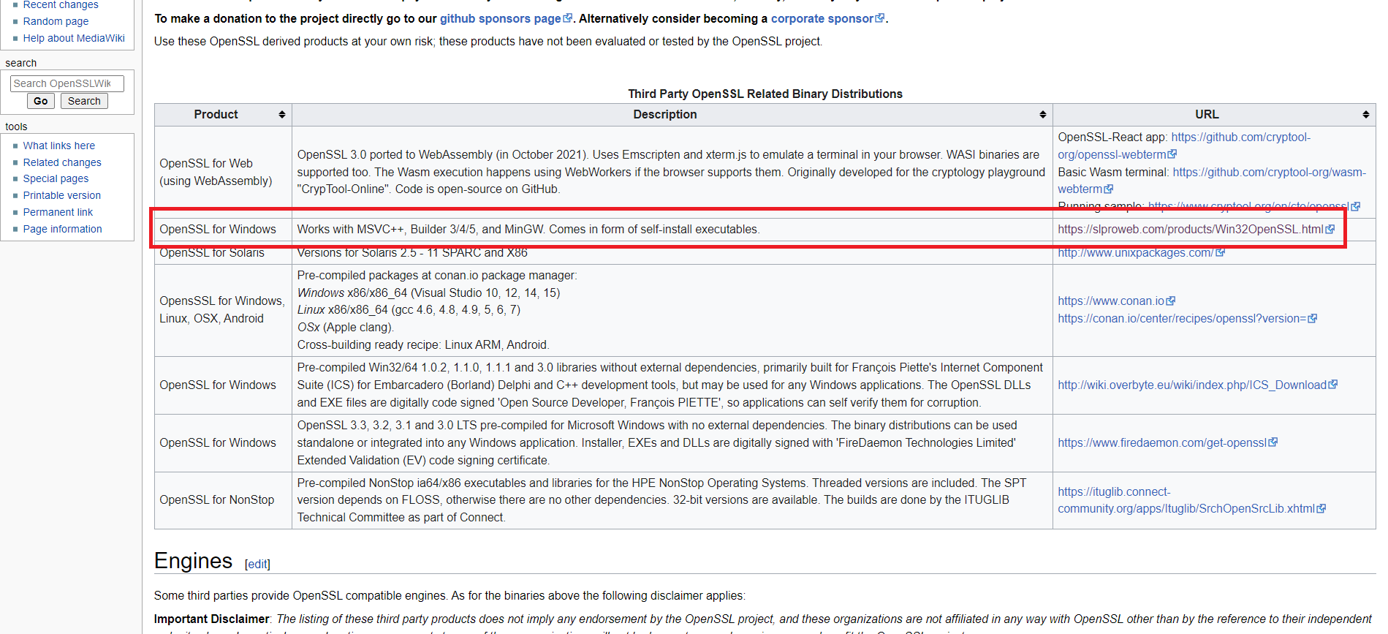
Website

Slide 31
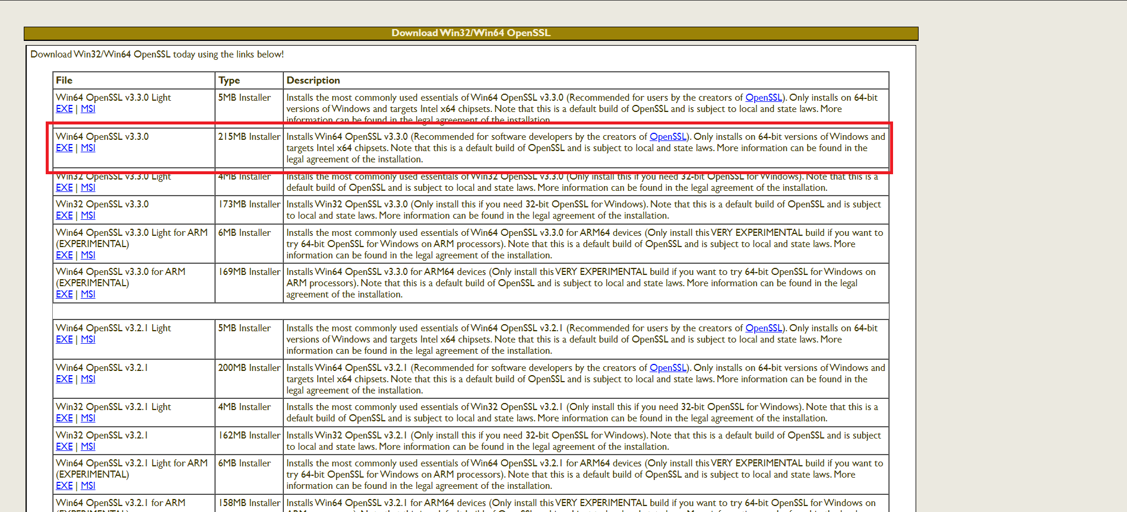
Website

Slide 32
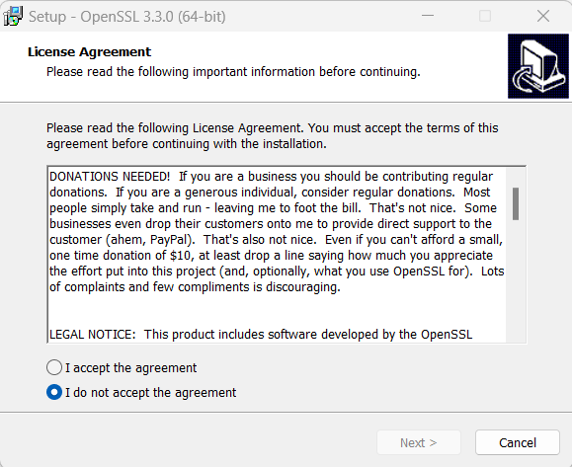
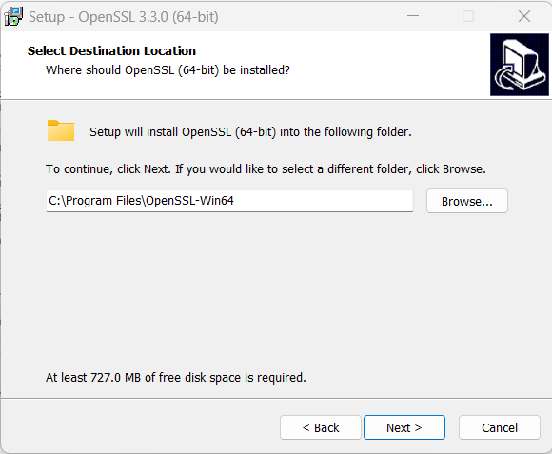
Installation

Slide 33
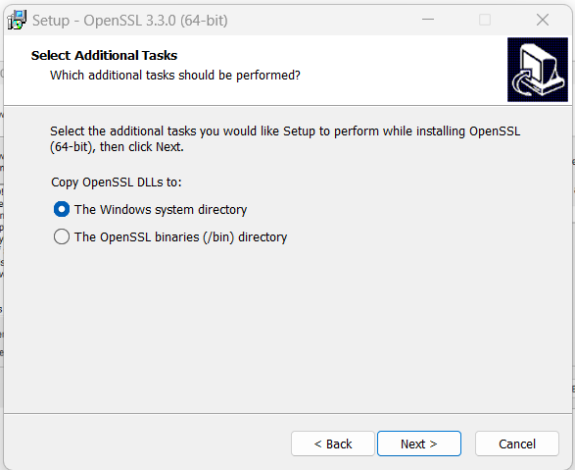
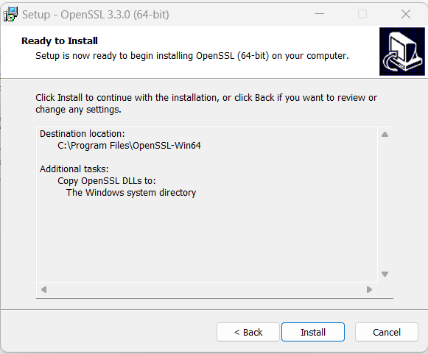
Installation

Slide 34
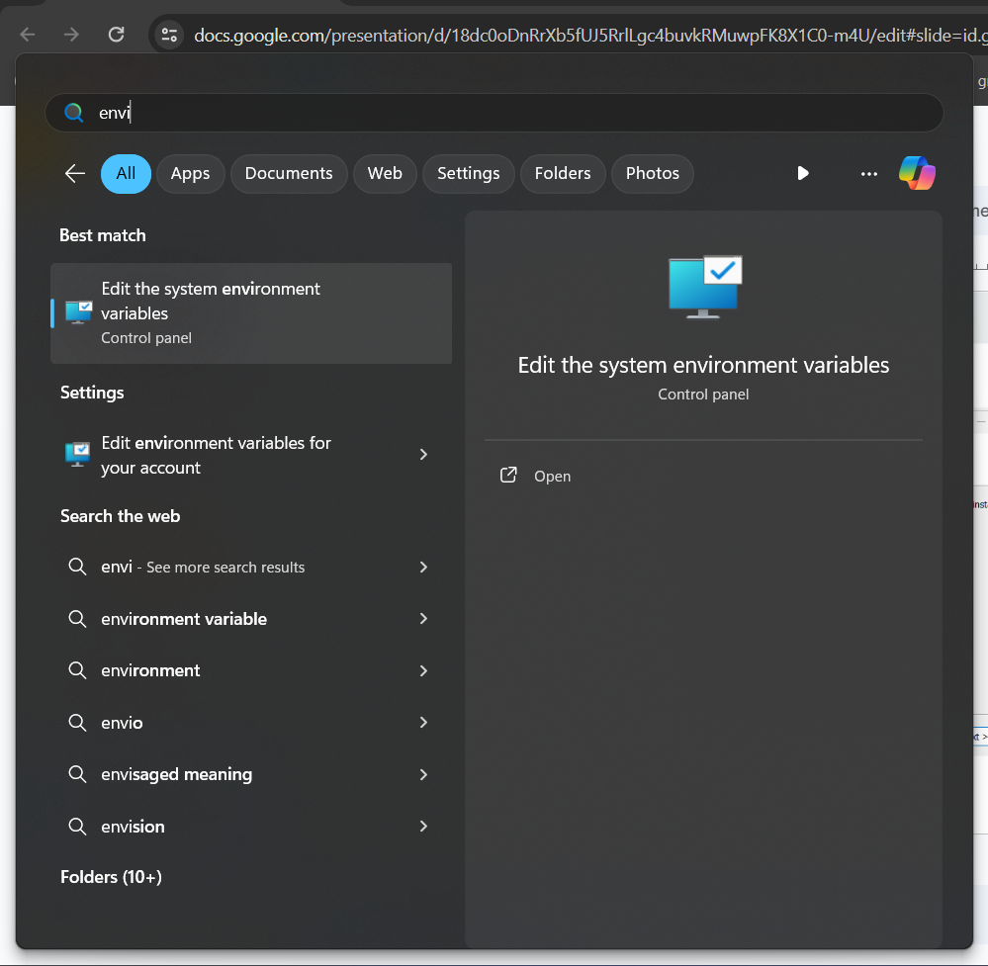
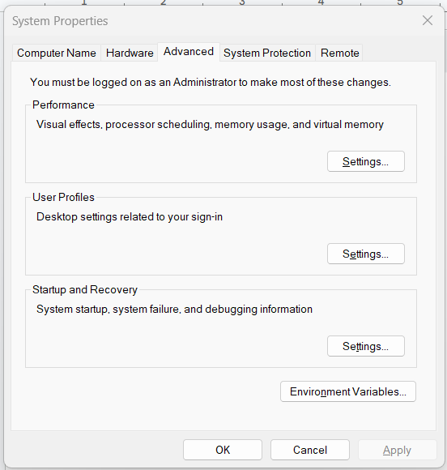
Environmental Path

Slide 35
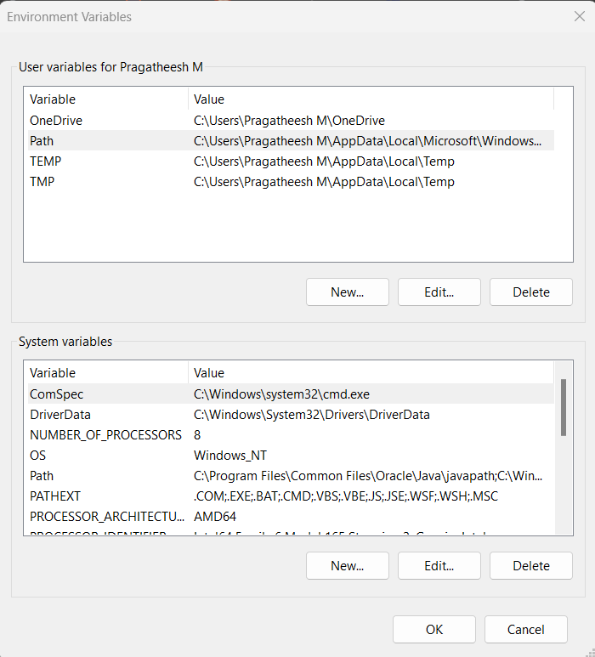
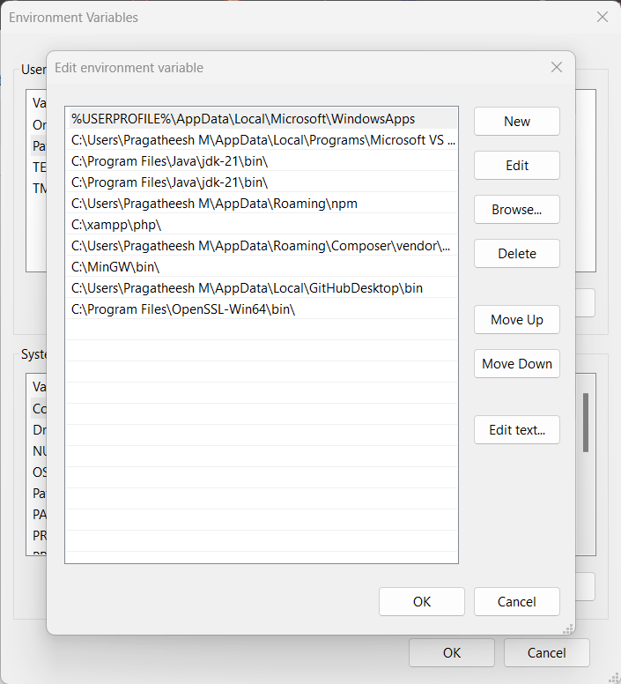
Environmental Path

Slide 36
Generating RSA Public Keys
Creating RSA Keys
openssl genrsa -out server.key 2048
openssl genrsa -out client.key 2048
Here “genrsa” - generates an RSA key
“-out” - specifies output filename
“2048” - specifies the number of bits

Slide 37
Generating Certificate Signing Requests (CSRs)
openssl req -new -key server.key -out server.csr
openssl req -new -key client.key -out client.csr
Here “openssl req” - command to create CSR
“-new” - Generates a new CSR
“-key server.key || -key client.key” - specifies which key to use to create CSR
“-out server.csr || -out client.csr” - specifies the output CSR filename

Slide 38
Generating Self-Signed Certificates
openssl x509 -req -days 365 -in server.csr -signkey server.key -out server.crt
openssl x509 -req -days 365 -in client.csr -signkey client.key -out client.crt
Here “openssl x509” - command to generate Self-signed Certificate
“-req” - Indicates input is required and is CSR.
“-days 365” - specifies validity period.
“-in server.csr || -in client.csr” - specifies input file
“-signkey server.key || -signkey client.key” - specifies signing key for certificate.
“-out server.crt || -out client.crt” - specifies the output file.

Slide 39
Viewing Informations of the certificates generated
View Description about the certificate:-
openssl x509 -in server.crt -text -noout
View the public key in the certificate:-
openssl x509 -in server.crt -noout -pubkey
These are used to view the hidden information in the certificates

